Slide 1
In this meeting we will explain the way in which we approach and teach phonics in our school and how you can support this at home.
Phonics Meeting
September 2025

Slide 2
Phonics
The learning of letters and sounds to support the children in their reading and writing.
We use a scheme called ‘Read, Write, Inc’

Slide 3
What is Read Write Inc?
https://schools.ruthmiskin.com/training/units/56

Slide 4
What is phonics?
Phonics - the sounds that our alphabet represent.
We have 26 letters, 44 sounds and 150+ ways of writing those sounds!!
It is one of the most difficult languages to master!
We need to make sure our children learn these sounds quickly and that they are embedded. The best way to do that is have fun learning, but also repeat, practise and repeat again and again and again!

Slide 5
Read Write Inc has four main sections:
Speed Sounds
Word Time
Writing
Ditties and Storybooks
Notes:
Learning sounds and doing some reading and writing

Slide 6
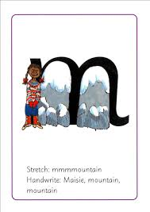
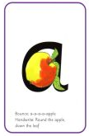
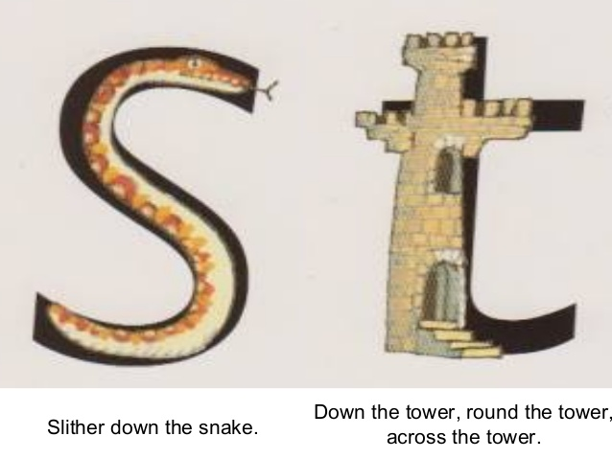
Speed Sounds
  Each week we will introduce the children to new letter sounds.
  RWI do this is a specific order.
  Each letter has a rhyme to help the child form the letter correctly.
Notes:
Model each sound, explain not adding ‘u’ at end. Write it lower case unless to start a name or as you would normally eg a sentence
Support – spot sound in books, at tesco, play i-spy

Slide 7
The sounds are split up into 3 sets.
There are BOUNCY sounds…
…and STRETCHY sounds!

Slide 8
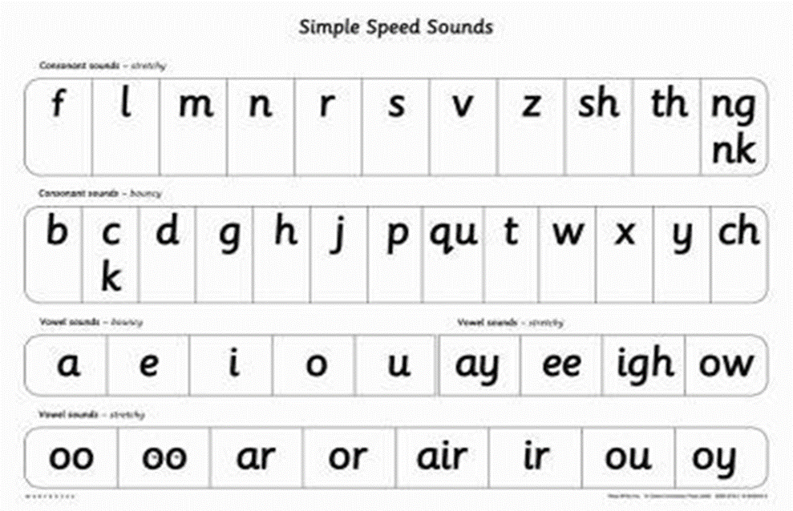
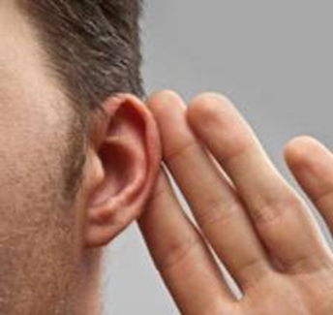
Set 1 sounds

Slide 9
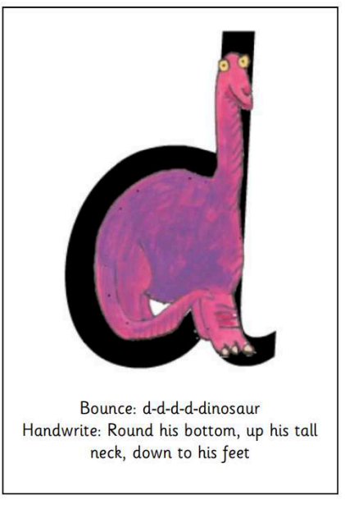
Tomorrows sound -
d
MTYT

Slide 10
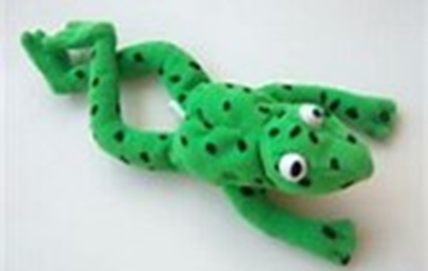
Fred Talk
Fred the Frog helps us to learn our sounds!
He only speaks in sounds!
He helps the children listen to the sounds and begin to blend the words without reading them.

Slide 11
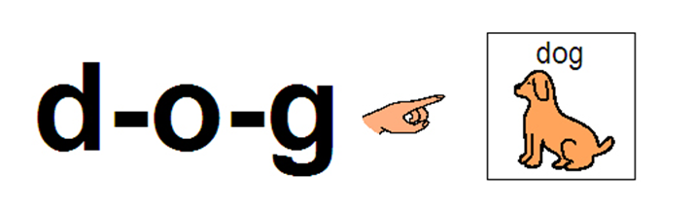
Word Time
Fred is not the only way we teach children to blend sounds.
We use the letter cards, magnetic letters and various games.
This section of the lesson is called Word Time.

Slide 12

Writing
….and now
write it!

Slide 13
To help the children write the sounds we use a rhyme.
These link to the letter pictures.
When the children write they are taught the correct sitting position and pencil grip.
Once the children are secure writing some letters, as with reading, we begin to blend the letters to write some words.

Slide 14


Fred Fingers
Fred is back!
Don’t let your child copy your writing, encourage them to sound it out using Fred Talk and Fred Fingers.

Slide 15
Red and Green words
Red words e.g ‘the’ ‘be’ ‘saw’ (not decodeable at this stage. Some red words become green words once the ‘tricky’ sound has been taught.) These are in the home school diaries.
Green Words e.g ‘mat’ ‘sad’ ‘car’ (decodeable) – During Word Time sessions we work on sounding out, blending and speedy reading these words.
The children will also pick up, learn and spell other words from memory such as names of family members.
Notes:
Show green words, sound buttons and my turn your turn. At first children may say c-a-t can
Red tricky, need to be learnt.

Slide 16
Phonics groups
After introducing all the single sounds we will be assessing the children’s knowledge of them. They will then be split into 4 phonics groups.
Children are grouped by their sound knowledge and ability to blend.
The children will be sent home a Blending book, a Ditty sheet or a Story book. These are matched to the sounds they are learning.

Slide 17
Lastly, a few points about writing
The children all start in different places. Ranging from mark making to writing CVC words.
All mark making will improve pen control. Try to make learning fun so that your child wants to pick up a pen and have a go. This could be writing a shopping list, a register, making a car mat, drawing a map and labelling the places etc.
When writing their name please use a capital to start and then lower case letters.
If your child is reluctant to try writing, try magnetic letters, chalks, whiteboards, steam on the shower screen, with a stick in the mud etc.
Notes:
Brief examples of mark making type of work – paint brushes and water outside, chalk on the ground, writing in sand, whiteboards and pens, gloop,

Slide 18

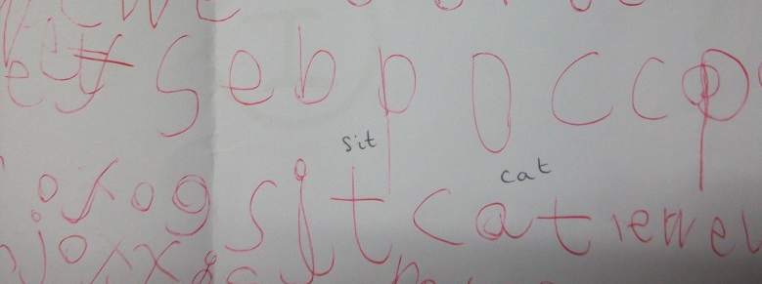
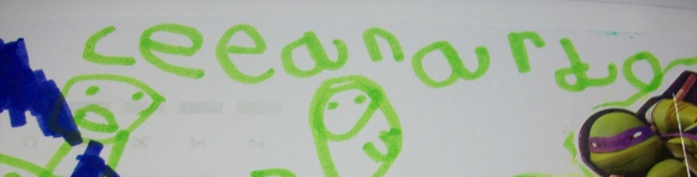
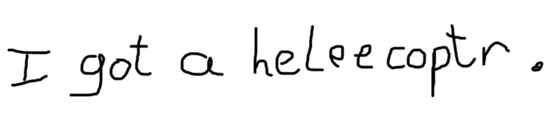
Emergent writing /
mark making
Some letter shapes
CVC words
Writing down all the sounds they can hear in a word.
Writing simple
sentences.
Notes:
Show board Ryan cvc Mia 1st and 2nd

Slide 19
Phonics at Home
Each Monday in our weekly letter we will let you know the letters we are focusing on that week. It also includes links to RWI sessions to do at home.
Encourage them to have a go at writing them or think of words beginning with that sound.
Remember to practise blending for reading and segmenting for writing.
Games – touch you l..e..g (talk like a robot)
Hands to stretch the sounds, clap the word.
Zig zag trellis.
Fred Fingers, especially when writing.

Slide 20
Thank You!
Tapestry
Please ask one of us if you have any questions.
Thank you for coming ☺

